Slide 1

Design Patterns Project
Creators:
Alon Shlomi & Dor Ferenc

Slide 2
Description And System Requirements
Our project is about the management of a transit organization control room.
The program that we are designing is going to be used at a control room.
Our Algorithm manages a data base of Cars, Drivers and Employees, And helps create reports.
Its purpose is to reduce redundancy by uniting scattered data and actions into an organized and easy to access databases.
The system goal is to make it easy for the user to add events that happen on real time. To achieve that the system unites many operations, that can be done by different personnel, into one. The program also sorts the operation’s info into an integrated database. All while prosecuting multiple actions by itself or reducing the actions that are necessary by making a process more efficient.

Slide 3
The User
The main user of the program is a Control room employee. By using the program, he can add a loss or new event to the database in one forum. This forum later can be sent, edited, or viewed by his managers in one single place. Instead of sending each piece of information to a different person all of it is united in one form. This saves the employee a lot of time entering the data and makes it easier for his superiors or colleagues to view the info.
The program can also be used by a car lot manager and office manager in the case of real data (a real lost getting found in the transit company, real event occurring, excreta…) being received by them. This again makes it one organized location where all is stored efficiently.

Slide 4

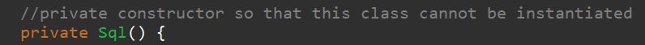
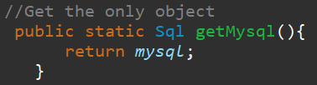

Singleton Pattern
Create Singleton Class
With private constructor
And static function that returns the only object
Example of getting the only object and using it

Slide 5

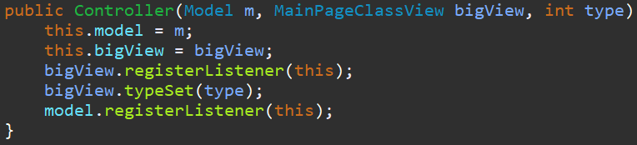
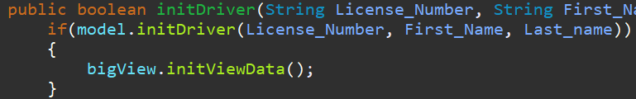
MVC Pattern
Create MVC patternern
The controller register itself as a listener in the model and the view
Example for using MVC: The view call to the controller
The controller transfer the order to the model which send back to the controller if the order succeed, and than the controller update the view accordingly to the result

Slide 6
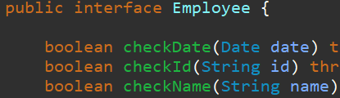
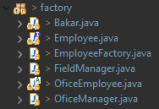
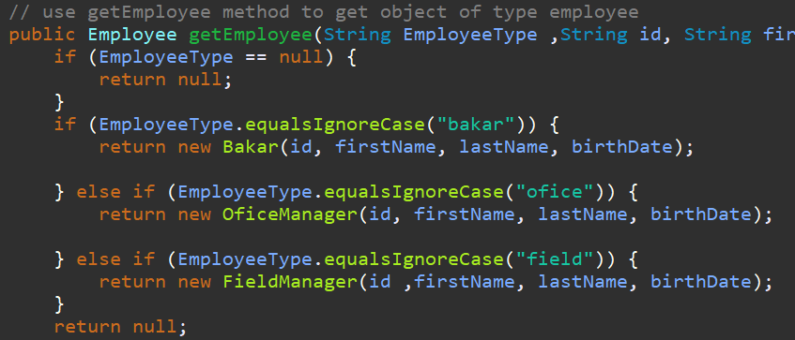
Factory Pattern
Create different classes of employees for different permissions in the system with shared functionsn
Create a Factory to generate object of concrete class based on given information.
Using the factory

Slide 7
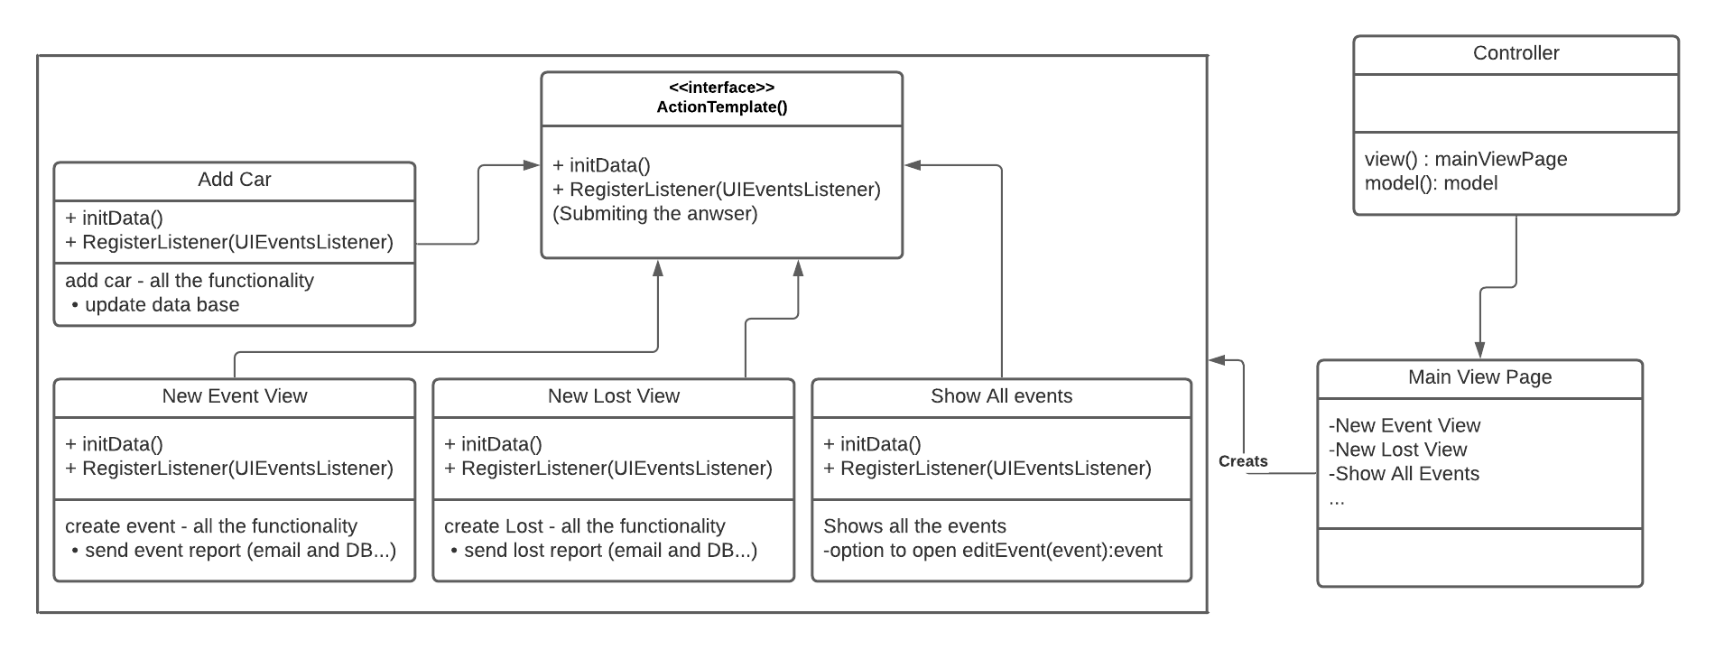
Facade Pattern
Facade pattern hides the complexities of the system and provides an interface to the client using which the client can access the system. This type of design pattern comes under structural pattern as this pattern adds an interface to existing system to hide its complexities.
This pattern involves a single class which provides simplified methods required by client and delegates calls to methods of existing system classes.

Slide 8
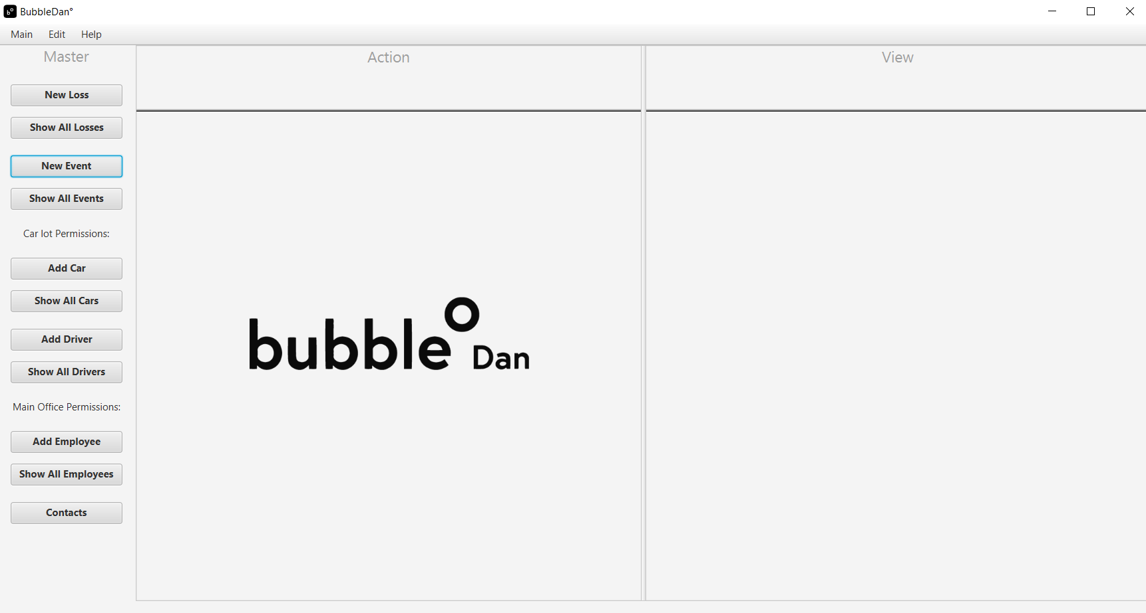
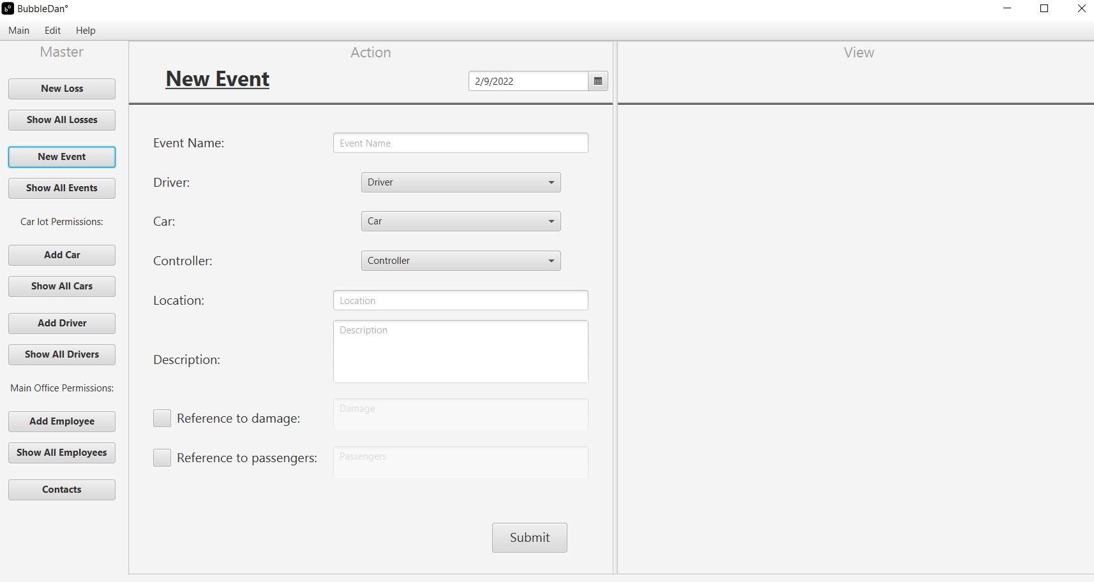
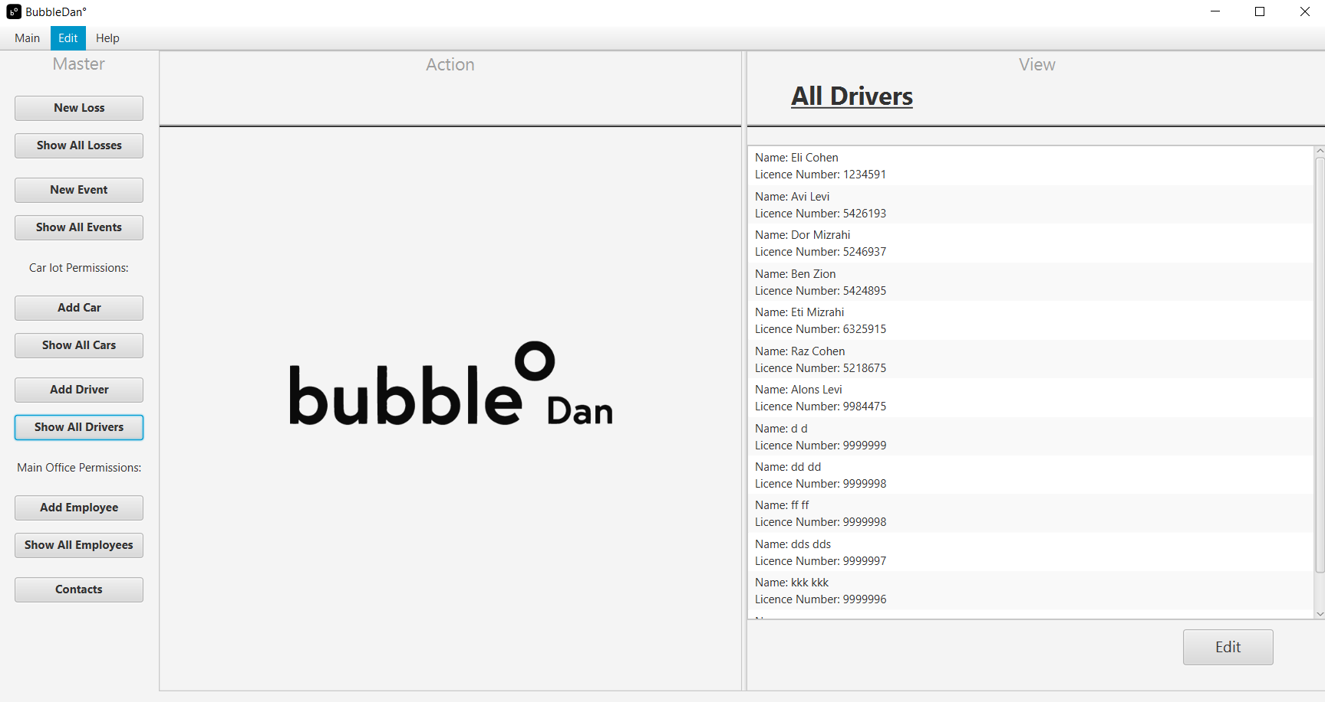
Facade Pattern
Our implantation of the façade design pattern is the main page view.
The client gets 1 page that does it all. Multi pages in 1 and multi functionality of each simplified page.
For example: sending mails, while updating the data base.

Slide 9
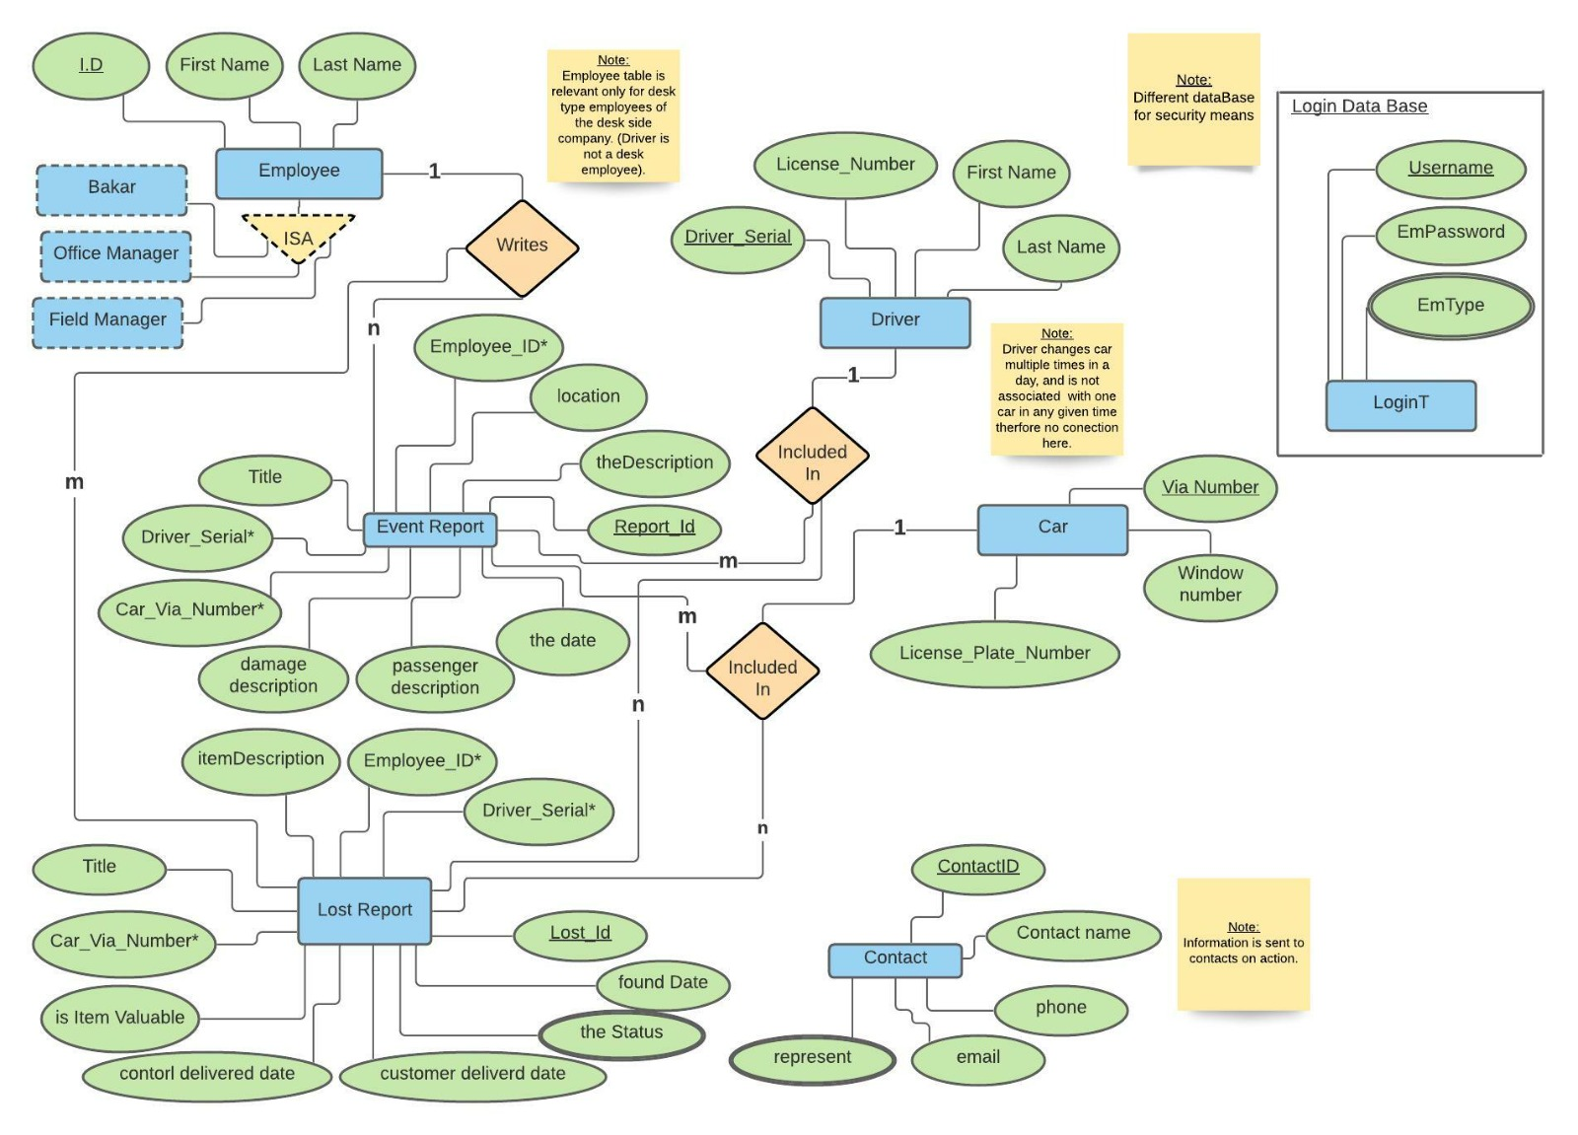
ERD

Slide 10
References
Façade pattern: https://www.tutorialspoint.com/design_pattern/facade_pattern.htm

